Slide 1


Department Salary investigation
Finding Statistically Significant Differences among the salaries of 5 Departments

Slide 2
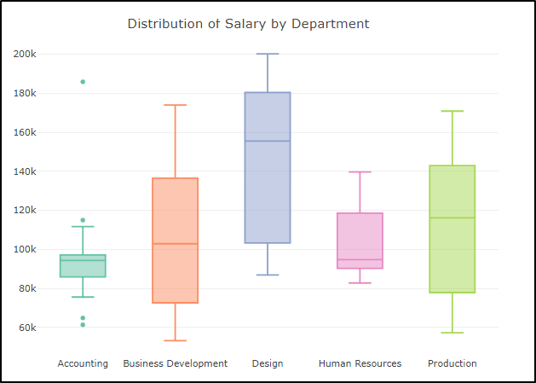
Salary Distribution
Clearly, the Design Department has a much higher average (median) than the other 4 departments.*
* Note: We also conducted a formal statistical test , ANOVA, to confirm this was a true discrepancy. See Appendix for details.

Slide 3
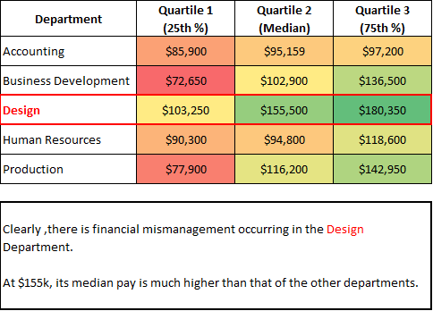
Salary Distribution
Clearly, the Design Department has a much higher average (median) than the other 4 departments.*
* Note: We also conducted a formal statistical test , ANOVA, to confirm this was a true discrepancy. See Appendix for details.

Slide 4
Appendix
ANOVA Test Results

Slide 5
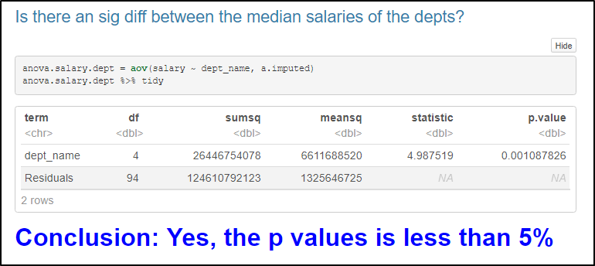
ANOVA: TEST FOR DIFFERENCE AMONG MEANS
A formal ANOVA test confirms there exists a difference among mean salaries among the 5 departments

Slide 6
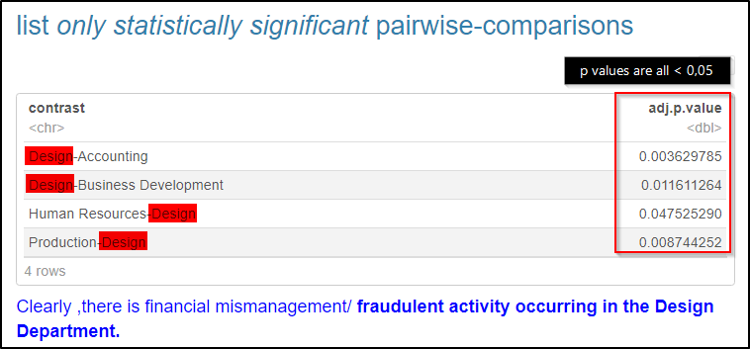
ANOVA: TEST FOR DIFFERENCE AMONG MEANS
Digging Deeper, we can see that this is caused by pairwise differences exclusively between the Design department and the other departments.

